Slide 1
React Web Applications Master Class
Modern React
SoftUni Team
Technical Trainers
Software University
http://softuni.bg

Slide 2
Table of Contents
React Hooks
React Router
Code Splitting
React Profiler

Slide 3



Learn to Search in Internet
The course assignments require to search in Internet
This is an important part of the learning process
Some exercises intentionally have no hints
Learn to find solutions!
Software development includes everyday searching and learning
No excuses, just learn to study!
Developers learn new technologies, tools, languages every day!

Slide 4
React Hooks

Slide 5
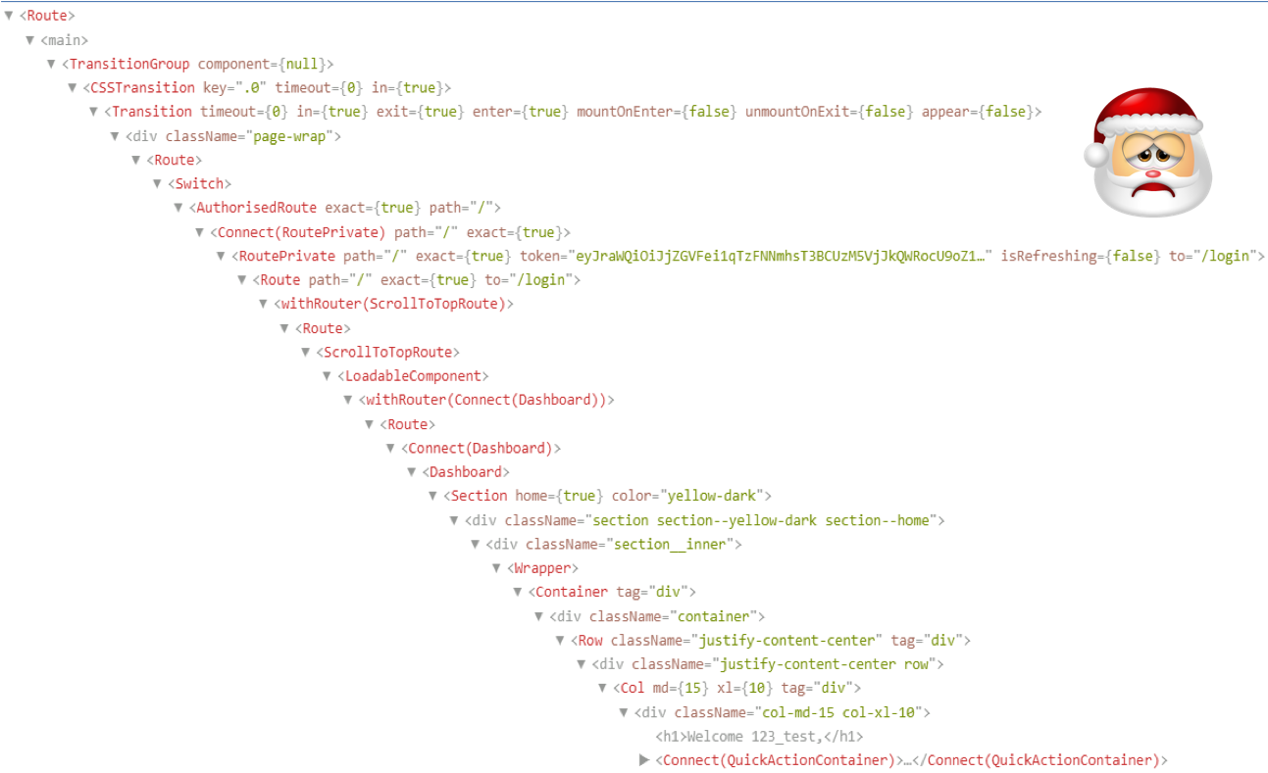
Problem 1
Reusing logic - Complex patterns

Slide 6
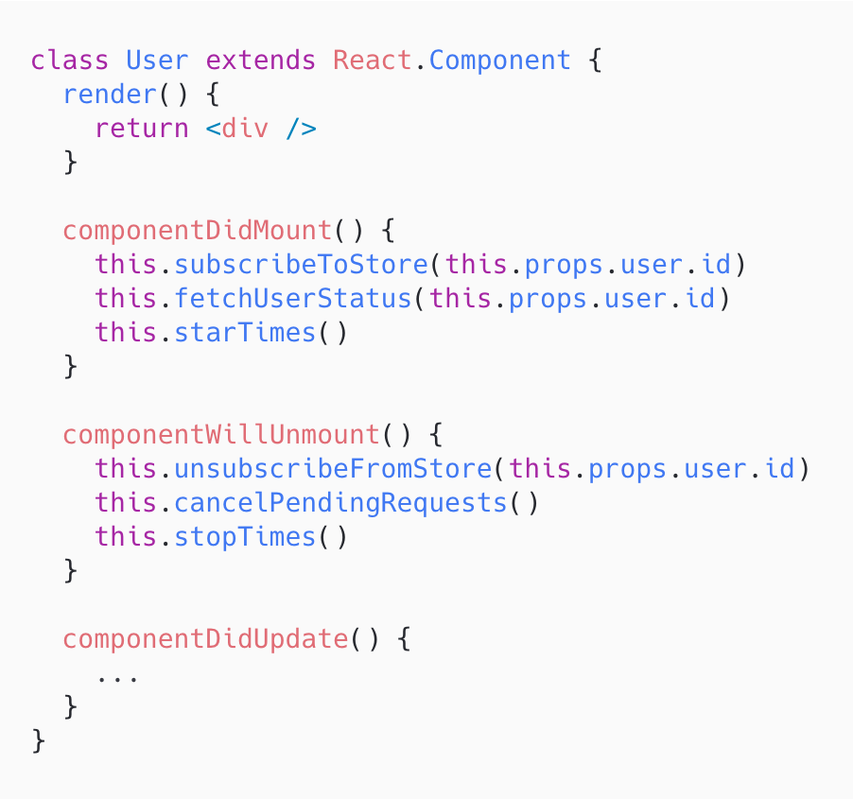
Problem 2
Huge components

Slide 7
Problem 3
Confusing classes
Minified version won’t minify method names
Unused methods won’t get stripped out
Difficult with hot reloading and compiler optimisation

Slide 8
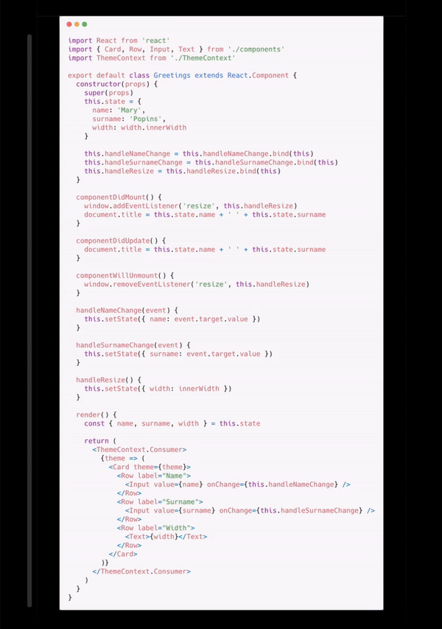
Visual example

Slide 9
What are hooks ?
Hooks are regular JavaScript functions that let you use React features (like state)
Adoption Strategy
No breaking changes
Minimum increase in package size ~ 1.5 kB

Slide 10
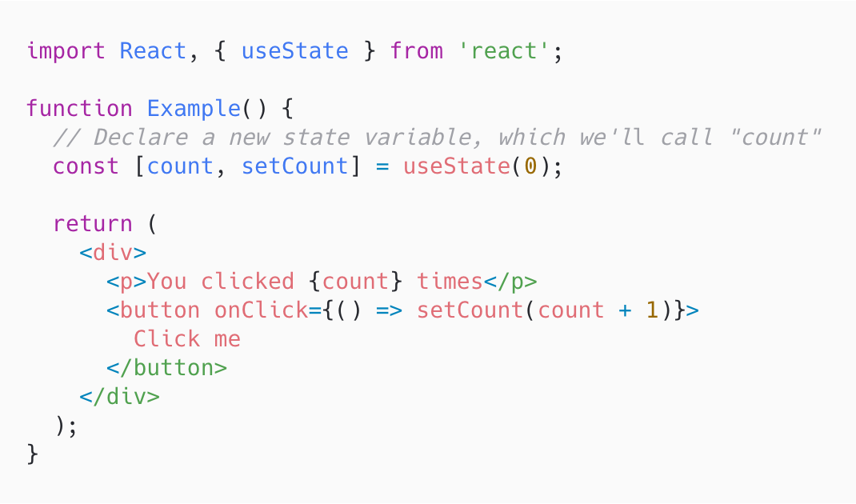
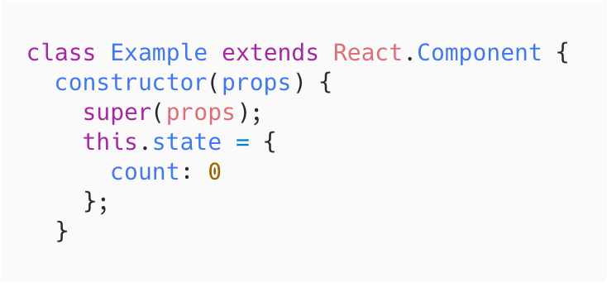
Built-in useState hook

Slide 11
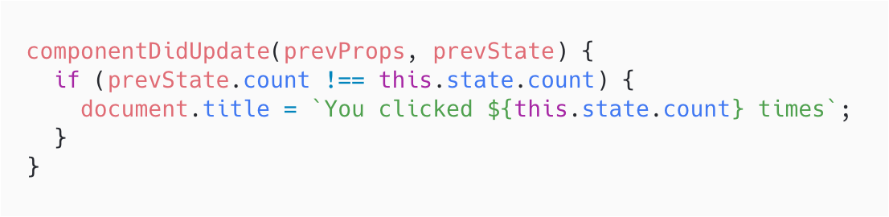
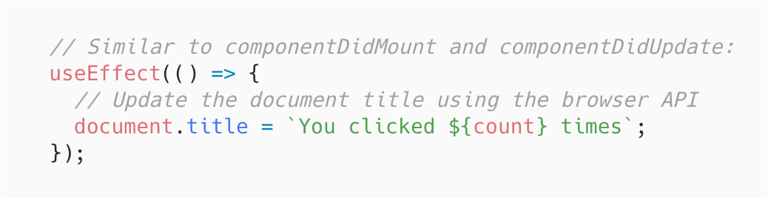
Built-in useEffect hook
Perform side effects from a function - data fetching, subscriptions, manual change of the DOM
Serves the same purpose as componentDidMount, componentDidUpdate, and componentWillUnmount
Let's you specify how to “clean up” by returning a function
Optimizing Performance

Slide 12
Built-in useLayoutEffect
Runs synchronously immediately after React has performed all mutations
Useful for DOM measurements

Slide 13
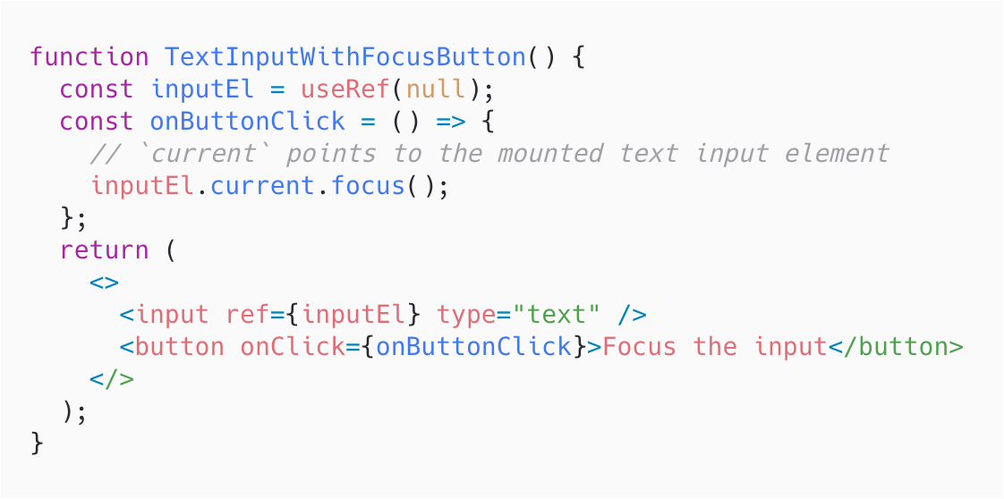
Built-in useRef

Slide 14
Built-in useMemo
Recomputes the memoized value when one of the dependencies has changed

Slide 15
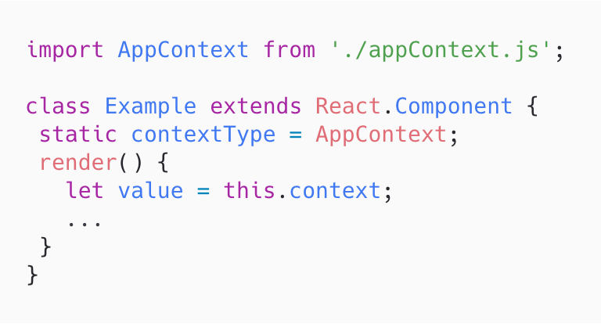
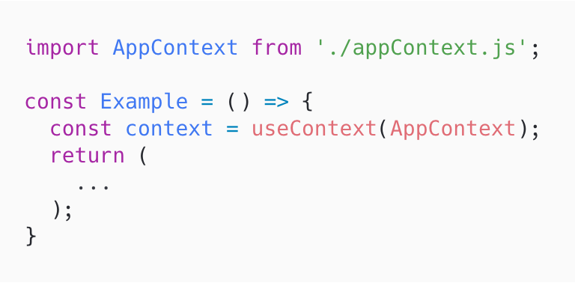
Built-in useContext
Accepts a context object (the value returned from React.createContext) and returns the current context value for that context

Slide 16
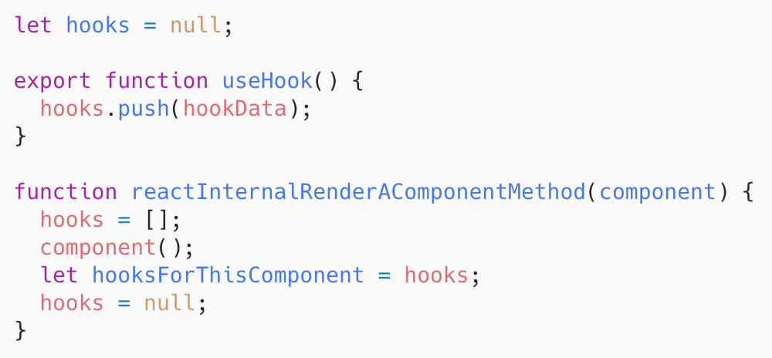
Rules of hooks
Only Call Hooks at the Top Level of your React function
Only Call Hooks from React Functions
To enforce rules automatically use eslint-plugin-react-hooks

Slide 17
Write your own hook
Lets you extract component logic into reusable functions
A custom Hook is a JavaScript function whose name starts with ”use” and that may call other Hooks

Slide 18
React Hooks
DEMO

Slide 19
React Router

Slide 20
Philosophy
Static Routing - routes are declared before the app starts/renders
Dynamic routing - routing takes place as your app is rendering, not in a configuration or convention outside of a running app

Slide 21
Routers
<BrowserRouter />
Uses regular URL paths - http://example.com/your/page
Uses browser's session history API
Requires server configuration
<HashRouter />
Stores the current location in the hash portion of the URL http://example.com/#/your/page
No limitations on supported browsers
No special server configuration is needed

Slide 22
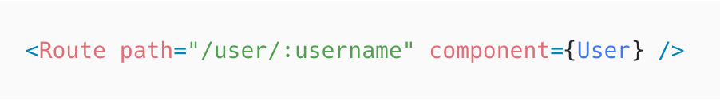
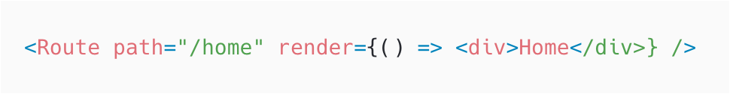
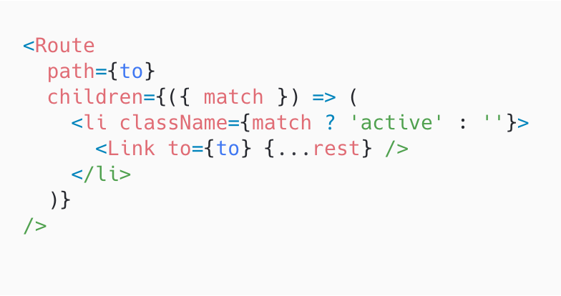
Route Matchers - Route
<Route />
Renders some UI when its path matches the current URL.
Render methods
Component
Render function
Children function
Route props
match
location
history

Slide 23
Route Props
match - contains information about how a <Route path /> matched the URL
params - Key/value pairs parsed from the URL corresponding to the dynamic segments of the path
isExact - true if the entire URL was matched (no trailing characters)
path - The path pattern used to match. Useful for building nested <Route>s
url - The matched portion of the URL. Useful for building nested <Link>s.

Slide 24
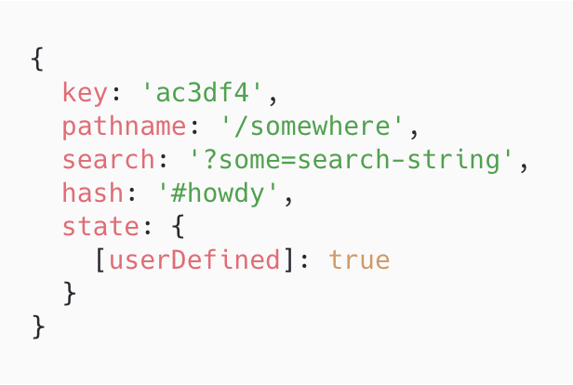
Route Props
location - represent where the app is now, where you want it to go, or even where it was

Slide 25
Route Props
history - wrapper around the several different implementations for managing session history in JavaScript in various environments
length - The number of entries in the history stack
action - The current action (PUSH, REPLACE, or POP)
location - The current location stack. Only available in browser and memory history.
push(path, [state]) - Pushes a new entry onto the history stack
go(n) - Moves the pointer in the history stack by n entries
replace(path, [state]) - Replaces the current entry on the history
goBack() - Equivalent to go(-1)
goForward() - Equivalent to go(1)

Slide 26
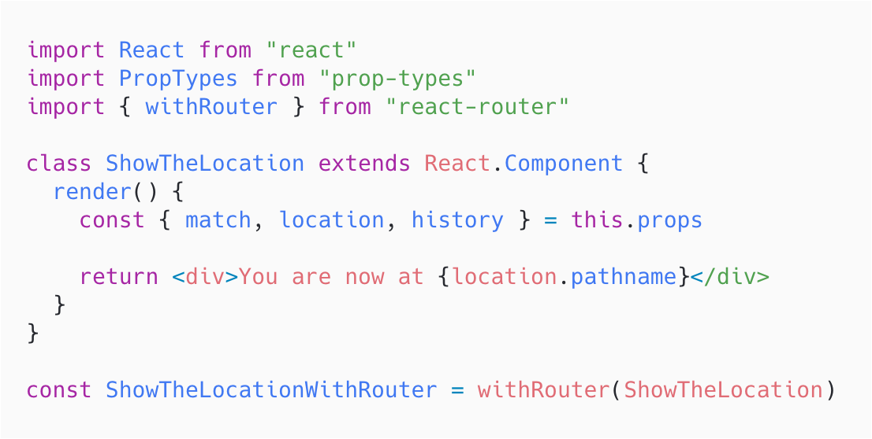
Route Matchers - Route
withRouter - passes match, location, and history props to the wrapped component whenever it renders

Slide 27
Route Matchers - Switch
<Switch />
Renders a route exclusively. In contrast, every <Route> that matches the location renders inclusively

Slide 28
Route Matchers
DEMO

Slide 29
Route Navigation
<Link /> - Create links in your application
<NavLink /> - Special type of <Link> that can style itself as “active” when its to prop matches the current location
<Redirect /> - Will navigate using its to prop

Slide 30
Route Navigation
DEMO

Slide 31
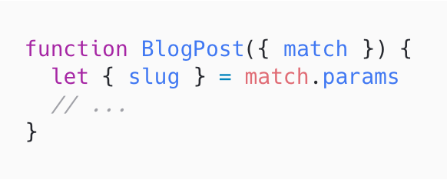
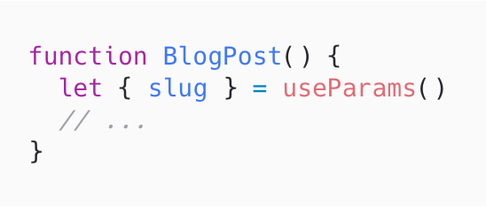
React Router v5.1
useParams()
useHistory()
useLocation()

Slide 32
Code Splitting

Slide 33
Introduction
Bundling - following imported files and merging them into a single file: a “bundle
Laziness - an evaluation strategy which delays the evaluation of an expression until its value is needed
Code Splitting - Slice a code base into smaller chunks that can be loaded on-demand

Slide 34
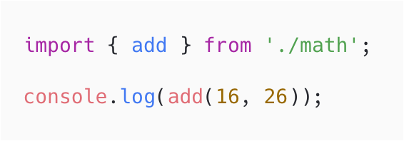
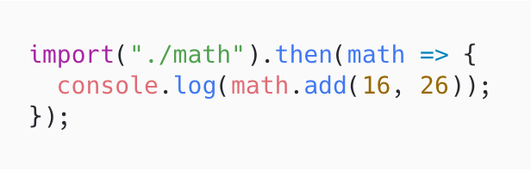
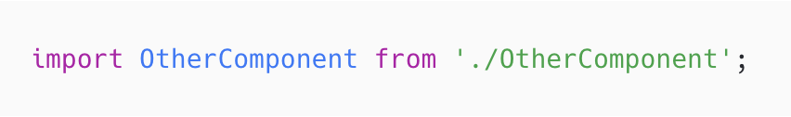
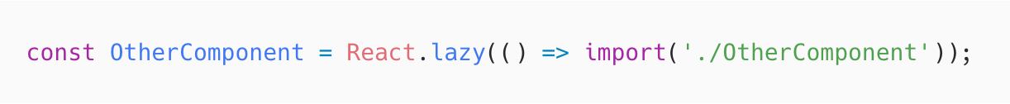
React.lazy
Dynamic import
React.lazy

Slide 35
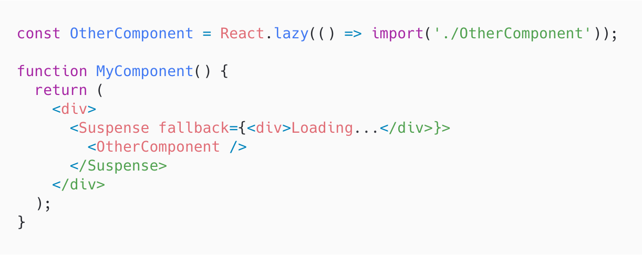
Suspense
Allows us to show fallback content

Slide 36
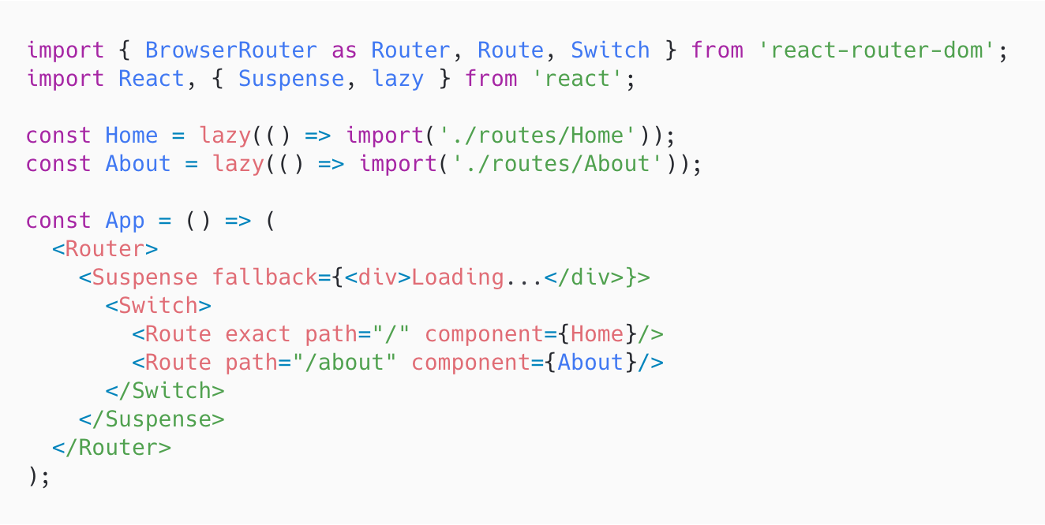
Route-based code splitting

Slide 37
Code splitting
DEMO

Slide 38
React Profiler

Slide 39
Introduction
Render phasе - determines what changes need to be made to e.g. the DOM
Commit phase - React applies any changes

Slide 41






СофтУни диамантени партньори

Slide 42






СофтУни диамантени партньори

Slide 43





Trainings @ Software University (SoftUni)
Software University – High-Quality Education, Profession and Job for Software Developers
softuni.bg
Software University Foundation
http://softuni.foundation/
Software University @ Facebook
facebook.com/SoftwareUniversity
Software University Forums
forum.softuni.bg

